Slide 1
Taxi Demand Prediction
Pranavi Vasa

Slide 2
Overview
About Me
About the Company
Formulation to Data Science problem
Data Collection
Data Exploration and Pre-processing
Exploratory Data Analysis
Feature Engineering
Modelling
System Scalability
Conclusion

Slide 3
About the Company
Domain
Ride sharing company
Business
Groups
Objectives and Constraints
Worldwide

Slide 4
Automated System Structure
Formulation to Data Science problem
Data Science Pipeline

Slide 5
Automated System Structure
Formulation to Data Science problem
Predicting the number of requests at a given time and given location.
This is a geo-spatial time series analysis
Data Science Pipeline
Data Collection
Data exploration and pre-processing
Exploratory Data Analysis
Feature Engineering
Modelling

Slide 6
Automated System Structure
Data Collection
Given dataset consists of geographical location and time of the user hailed the taxi
Data
Longitude
Latitude
Time of ride creation

Slide 7
Automated System Structure
Data Exploration
Removal of outliers
Location Clustering
Time binning
Frequency calculation
Fill missing time bins

Slide 8
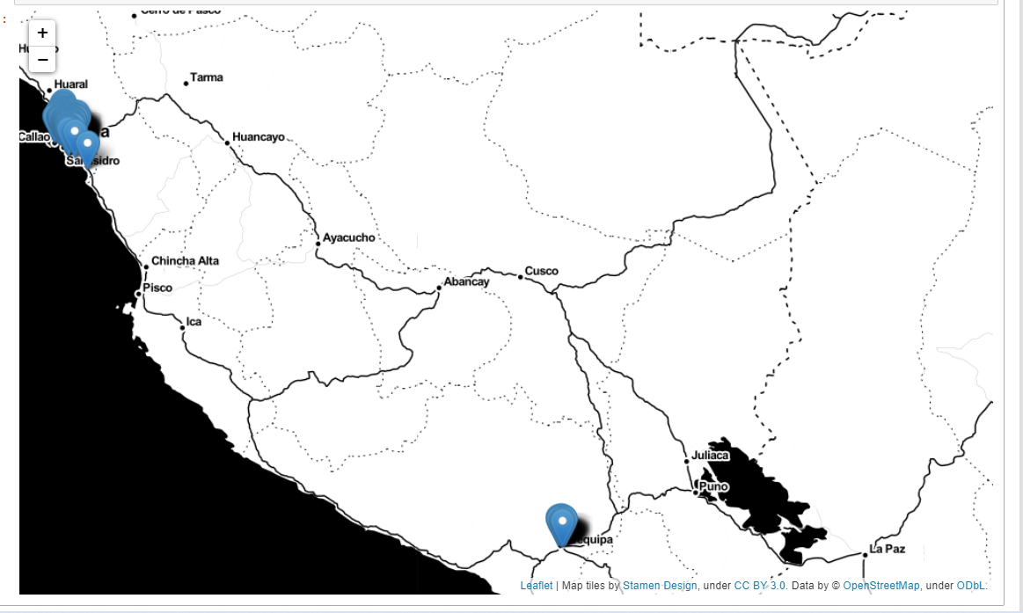
Automated System Structure
Outlier detection
Located sample of the points on the graph and found out that most of the samples given are of city ‘Lima’ and some points are of city ‘Arequia’.
Retained only ‘Lima’ city points

Slide 9
Automated System Structure
Feature Engineering and Data Pre-processing
Location clustering: For this used h3 and clustered the locations.
Time binning: Given data is continuous in time and asked for 20-minute time interval. So binned time to 20-min intervals.
Frequency calculation: Taxi demand is calculated by counting number of requests at a particular location and particular time bin.

Slide 10
Automated System Structure
Feature Engineering and Data Pre-processing
Data filling: There are multiple time points where taxi demand was not calculated. This is because there are no taxi request at that time and location. So have filled missing time values, and filled the missing frequency values with ‘0’.

Slide 11
Automated System Structure
Modelling
This is geo-spatial time series problem.
Different methods to solve this problem.
For each location, we can train a different model. It will have a model trained for each location
Train one model with all the inputs. So, it takes all the inputs at once. Disadvantage with this approach is that the model tends to become large and takes more time to train.
Same model on every location.

Slide 12
Automated System Structure
Modelling
Train –Test (80%-20%)
Divided training data into 80% train data and 20% test data
Training models
Auto_arima
Lstm
Evaluation
Root mean square error

Slide 13
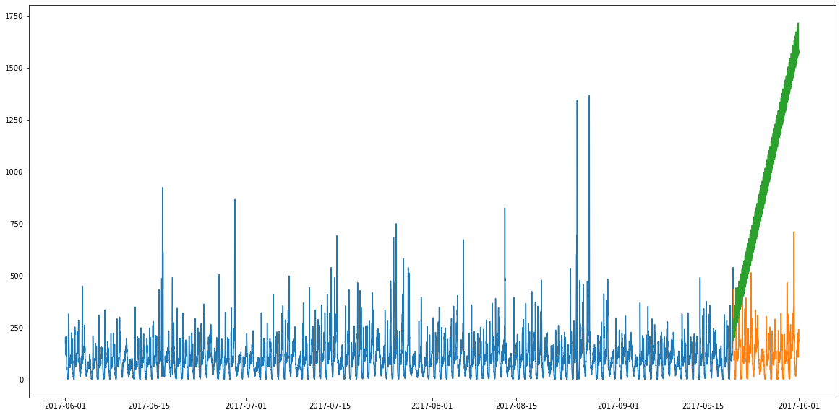
Model Performance
Auto arima model performance on the data.
Before balance
After balance

Slide 14
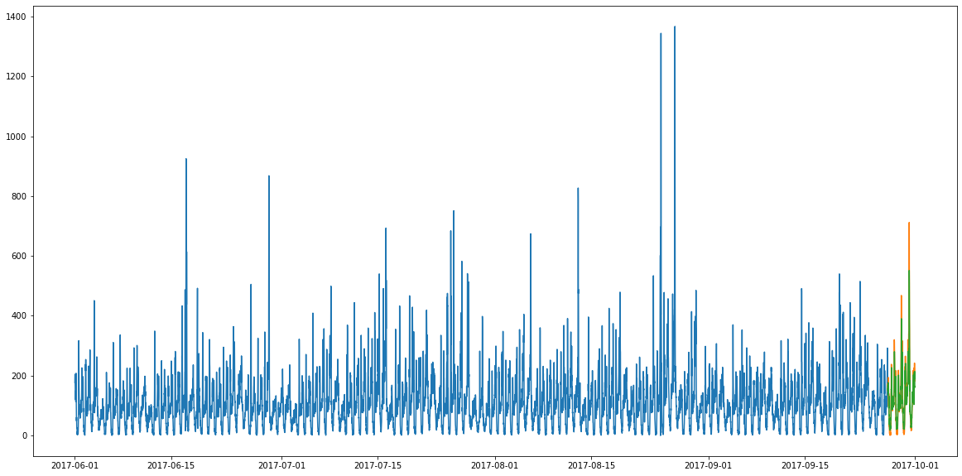
Model Performance
LSTM model performance on the data.
Before balance
After balance

Slide 15
Results Interpretation
Lstm model produced the good results and the root mean square error is also small for lstm
auto_arima rms value – 908.88
lstm rms value – 11.025

Slide 16
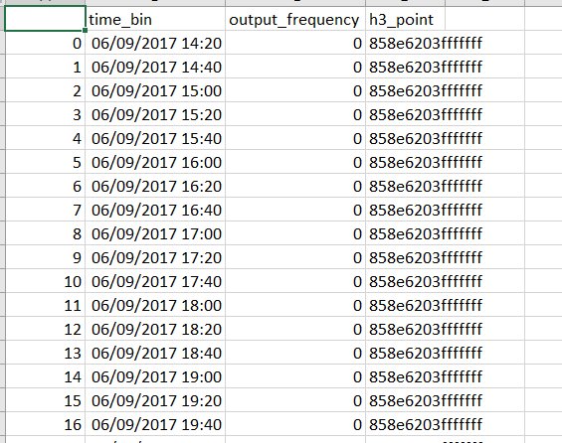
Results
For this problem ‘LSTM’ is considered and produced the results. Results can be found in ‘final_output.csv’

Slide 17

Deployment
Created Dockerfile for deployment.

Slide 18
Conclusion
Using Data science Techniques able to predict the demand at a particular time bin and particular location.

Slide 19
Future Work
Apply more machine learning models.
Implement parameter tuning for the models.
Try with varying grid size.
Can deploy the model as an API through frameworks such as Flask, Django.

Slide 20
THANKS!
Any questions?

